Slide 1
Data Analytics – Lesson 20 Introduction to Text Analytics using R
Jeffrey Strickland, Ph.D., CMSP, ASEP
CEO Humalytica Analytics

Slide 2
Text Analytics
Sentiment Analysis
aims to determine the attitude of a speaker, writer, or other subject:
with respect to some topic
the overall contextual polarity
emotional reaction to a interaction, or event
The attitude may be
a judgment or evaluation
affective state (emotional state author)
the intended emotional communication
widely applied to voice of the customer materials such as:
reviews and survey responses
online and social media
healthcare materials for applications
Topic Modeling
Used in machine learning and natural language processing
A type of statistical model for discovering the abstract "topics" that occur in a collection of documents.
Frequently used text-mining tool for discovery of hidden semantic structures in a text body
The "topics" produced are clusters of similar words
captures this intuition in a mathematical framework, which
allows examining a set of documents
discovering what the topics might be
discovering what each document's balance of topics is
based on the statistics of the words in each

Slide 3
Packages We May Need For Text Analytics
R frameworks for text analytics
Packages we need to load
package 'tm' (and plugins)
package 'RcmdrPlugin.temis'
package 'openNLP'
package 'RWeka'
package 'monkeylearn'
package 'udpipe'
package 'janeaustenr'
Package 'SnowballC'
install.packages("tidytext")
install.packages("wordcloud")
install.packages("tidyr")
install.packages("ggplot2")
install.packages("stringr")
install.packages("dplyr")
install.packages("janeaustenr")

Slide 4
Package 'tm'
Capabilities
Plug-ins
provides a comprehensive text mining framework for R
count-based analysis methods
text clustering
text classification
string kernels
tm.plugin.dc: distributes local files or Hadoop Distributed File System
tm.plugin.mail: imports mail messages from archive
tm.plugin.alceste: imports text corpora written in a file in the Alceste format.
tm.plugin.factiva: imports press and web corpora from Dow Jones Factiva
tm.plugin.lexisnexis: imports press and web corpora from LexisNexis
tm.plugin.europresse: imports press and web corpora from Europresse.
tm.plugin.webmining: imports news feeds in XML and JSON formats

Slide 5
RcmdrPlugin.temis
Capabilities
Documentation
Rcommander plug-in providing an integrated solution to perform a series of text mining tasks such as:
importing and cleaning a corpus
analyses like terms
documents counts
vocabulary tables
terms co-occurrences
documents similarity measures
time series analysis
correspondence analysis
hierarchical clustering
https://cran.r-project.org/package=RcmdrPlugin.temis
Can list terms by frequency of occurrance
Can build the list by level of the variable
Uses hypergeometric distribution
Uses stop-words and stemming
Builds a two-way contingency table
Build vocabulary summary table over documents

Slide 6
dplyr
A grammar and data manipulation package
Functionality Sample
Provides a consistent set of verbs that help you solve the most common data manipulation challenges:
mutate() adds new variables that are functions of existing variables
select() picks variables based on their names.
filter() picks cases based on their values.
summarize() reduces multiple values down to a single summary.
arrange() changes the ordering of the rows.
provides a ﬂexible grammar of data manipulation
Identify the most important data manipulation verbs
Provide fast performance for in-memory data by writing key pieces in C++ (using Rcpp)
Use the same interface to work with data
no matter where it’s stored
whether in a data frame
whether in a data table
whether in a database.

Slide 7
koRpus
A set of tools to analyze text
Notes
automatic language detection
Hyphenation detection
several indices of lexical diversity (e.g., type token ratio, HD-D/vocd-D, MTLD) and
readability metrics like Flesch, SMOG, LIX, Dale-Chall
basic import functions for language corpora are also provided, to enable frequency analyses
supports Celex and Leipzig Corpora Collection file formats and measures like tf-idf
support for additional languages can be added on-the-fly or by plugin packages
'koRpus' also includes a plugin for the R GUI and IDE RKWard, providing graphical dialogs for its basic features
Note: For full functionality a local installation of TreeTagger is recommended.
The respective R package 'rkward' cannot be installed directly from a repository, as it is a part of RKWard.
To make full use of this feature, please install RKWard from <https://rkward.kde.org> (plugins are detected automatically).
Due to some restrictions on CRAN, the full package sources are only available from the project homepage.
To ask for help, report bugs, request features, or discuss the development of the package, please subscribe to the koRpus-dev mailing list (<http://korpusml.reaktanz.de>).

Slide 8
SnowballC
SnowballC: An R interface to the C libstemmer library that implements Porter's word stemming algorithm for collapsing words to a common root to aid comparison of vocabulary
Currently supported languages are Danish, Dutch, English, Finnish, French, German, Hungarian, Italian, Norwegian, Portuguese, Romanian, Russian, Spanish, Swedish and Turkish.
library(ggplot2)
wordStem(c("win", "winning", "winner"))
[1] "win" "win" "winner"

Slide 9
Text Formats for Analysis
Corpus
Tidy
a large and structured set of texts
used to do statistical analysis and hypothesis testing
validating linguistic rules within a specific language territory
may contain texts in a single language (monolingual corpus)
may contain texts in multiple languages (multilingual corpus).
keeps one token (typically a word) in each row
keeps each variable (such as a document or chapter) in a column.
When your data is tidy, you can use a common set of tools for exploring and visualizing them
This frees you from struggling to get your data into the right format for each task
lets you focus on the questions you want to ask.

Slide 10
Preprocessing – Build Corpus
# Load the R package for text mining and then load your texts into R.
library(wordcloud2)
library(yaml)
library(NLP)
library(tm)
library(SnowballC)
library(ggplot2)
#set a pseudonym for the directory
cname <- file.path("C:/Users/jeff/Documents/VIT_University", "texts")
cname
dir(cname)
#put the text into a corpus format
cdocs <- Corpus(DirSource(cname))
summary(docs)
inspect(docs)

Slide 11
Summary of Documents in Corpus
Length Class Mode
A one-eyed man in the kingdom of the blind.txt 2 PlainTextDocument list
All Things Data.txt 2 PlainTextDocument list
Analytics and Statistics.txt 2 PlainTextDocument list
Analytics is it more than a buzzword.txt 2 PlainTextDocument list
Bayesian networks.txt 2 PlainTextDocument list
Big Data Analytics and Human Resources.txt 2 PlainTextDocument list
Big Data The Good the Bad and the Ugly.txt 2 PlainTextDocument list
Call Center Analytics.txt 2 PlainTextDocument list
Classification Trees using R.txt 2 PlainTextDocument list
Clouds clouds and more clouds.txt 2 PlainTextDocument list
Cluster Models.txt 2 PlainTextDocument list
Cyber-Threat Risk Assessment using R.txt 2 PlainTextDocument list
Data Scientist are Dead Long Live Data Science.txt 2 PlainTextDocument list
Do you like my Ensemble.txt 2 PlainTextDocument list
Free SAS.txt 2 PlainTextDocument list
Getting the Question Right.txt 2 PlainTextDocument list
What are Association Rules in Analytics.txt 2 PlainTextDocument list
Where_did_all_the_Teaching_Go.txt 2 PlainTextDocument list
Where_did_all_the_Thinking_Go.txt 2 PlainTextDocument list
Why_Stand_Many_Have_Fallen.txt 2 PlainTextDocument list

Slide 12
Preprocessing – Remove Punctuation
# If necesasry, you can remove special characters.
docs <- tm_map(cdocs, removePunctuation)
for(j in seq(docs))
{
docs[[j]] <- gsub("/", " ", docs[[j]])
docs[[j]] <- gsub("â", " ", docs[[j]])
docs[[j]] <- gsub("o", " ", docs[[j]])
docs[[j]] <- gsub("???", " ", docs[[j]])
docs[[j]] <- gsub("T", " ", docs[[j]])
docs[[j]] <- gsub("@", " ", docs[[j]])
docs[[j]] <- gsub("\\|", " ", docs[[j]])
}
A oneeyed man in the kingdom of the blind Predicting the Unpredictable Almost nobody s competent Paul It s enough to make you cry to see how bad most people are at their jobs If you can do a halfassed job of anything you re a oneeyed man in the kingdom of the blind u009d Kurt Vonnegut Player Piano Abstract This article is about Predictive Modeling It explores the appropriateness of modeling in general and predictive modeling in particular as well as examining some pitfalls modeling is the process of formulating and abstracting a representation of a real problem based on simplifying assumptions Thus no model is an exact representation of reality Said a different way a model cannot fully represent a complex problem but can provide some insight into the problem and assist decision makers with applying solutions Inherent in this statement is that a predictive model is just one piece of a problem s solution and in some instances is just a support tool aiding the business... <truncated>

Slide 13
Preprocessing – Word Removal
#Remove unnecessary words & convert to lowercase:
docs <- tm_map(docs, removeNumbers)
docs <- tm_map(docs, tolower)
docs <- tm_map(docs, removeWords, stopwords("english"))
docs <- tm_map(docs, removeWords, c("can", "should", "would", "figure", "using", "will", "use", "now", "see", "may", "given", "since", "want", "next", "like", "new", "one", "might", "without"))
stand man fallen political article statement substitute color find just patriot whether citizen iran great britain cambodia brazil mexico canada germany even north korea stand fallen don t stand political parties ideology elect official stand fallen sit relative safety write harold witzk took sniper bullet kuwait city left lifeless along american spill blood freedom war train many soldier met defeat republican guard heart broken heard cpl jame mccoy died battle east just wrote letter mr mrs schneider regarding son iframe title centr emb player width height frameboard scrolling no allow fullscreen true margin height white afghanistan war veteran write name fallen soldier war order die memorial video thomas hawtorn az centralcom stand defence fort mchenri yearold lawyer amateur poet franci scott key penned poem september with bombard fort mchenri british ship royal navy baltimore harbor battle baltimore war aftermath stood december japanese royal navy conduct surpris... <truncated>

Slide 14
Preprocessing – Common Ending Removal
#Remove common word endings
wordlist<-c("substitute", "substitution", "substituting")
Docs <- #Strip unnecesary whitespace from your documents:
docs <- tm_map(docs, stemDocument)
docs <- tm_map(docs, stripWhitespace)
# Check to see if it worked.
inspect(docs[3])
writeLines(as.character(docs[[20]]))
Example: substitute, substitution, substituting, etc.
wordStem(wordlist)
[1] "substitut" "substitut" "substitut"
stand mani fallen polit articl statement substitut color find just patriot ”whether citizen iran great britain cambodia brazil mexico canada germani even north korea stand fallen don t stand polit parti ideolog elect offici stand fallen sit relat safeti write harold witzk took sniper bullet kuwait citi left lifeless along american spill blood freedom war train mani soldier met defeat republican guard heart broken heard cpl jame mccoy die battl east just wrote letter mr mrs schneider regard son ifram titleazcentr emb player width height frameboard scrolling no allow fullscreen tru margin height white afghanistan war veteran write name fallen soldier... <truncated>

Slide 15
Preprocessing – Transform to Matrices
#Create term-document matrix
tdm <- TermDocumentMatrix(docs)
#view it
tdm
#Create document-term matrix
dtm <- DocumentTermMatrix(docs)
#print a summary
dtm
<<DocumentTermMatrix (documents: 20, terms: 2940)>>
Non-/sparse entries: 6220/52580
Sparsity : 89%
Maximal term length: 46
Weighting : term frequency (tf)

Slide 16
Preprocessing - Organizes the Terms by Frequency
freq <- colSums(as.matrix(dtm))
length(freq)
ord <- order(freq)
m <- as.matrix(dtm)
dim(m)
write.csv(m, file="dtm.csv")
 | analyst | analyt | anoth | anyth | appeal | appli
A o .. the blind | 2 | 4 | 1 | 2 | 1 | 3
All .. ings Data | 2 | 3 | 0 | 3 | 0 | 0
Ana .. tatistics | 0 | 24 | 0 | 0 | 0 | 2
Ana .. buzzword | 4 | 36 | 0 | 1 | 0 | 0
Bay .. networks | 0 | 0 | 1 | 0 | 0 | 0
Big .. Resources | 0 | 19 | 0 | 1 | 0 | 0
Big .. the Ugly | 0 | 1 | 1 | 1 | 0 | 0
Cal .. Analytics | 0 | 2 | 1 | 2 | 0 | 0
Cla .. s using R | 0 | 1 | 0 | 0 | 0 | 2
Clo .. re clouds | 0 | 15 | 1 | 1 | 0 | 0

Slide 17
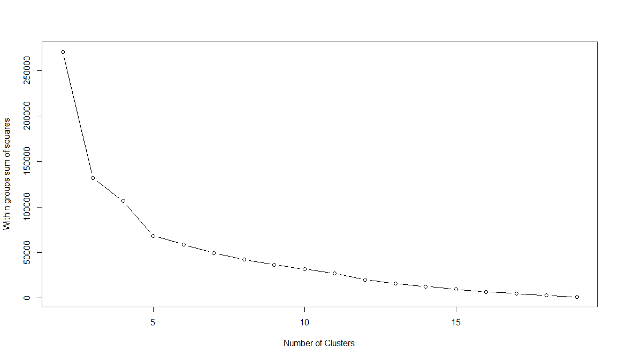
K-means Clustering – How Many Clsusters?

Slide 18
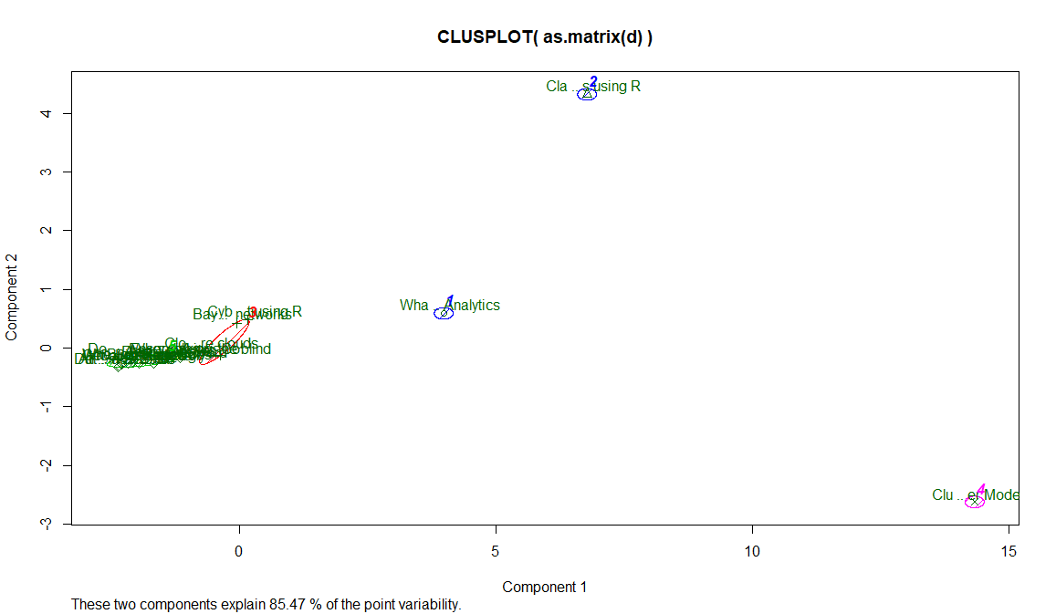
K-means Clustering

Slide 19
Projects Preview
The projects in this directory are for applied data analytics and are tailored for R and Python.
Data located at: https://github.com/stricje1/VIT_University/blob/master/Data_Analytics_2018/
Rojects include:
Credit Default Prediction Model - Machine Learning Models
Culturally Relevant Sentiment Analysis - Sentiment or Topic Analysis
American Politics Sentiment Analysis - Sentiment Analysis
Counterpoise Pro-ISIS Sentiment Analysis - Text Analytics

Slide 20
Project Requirements – Part 1
Thorough and original analysis or model (depending on goal)
Goal achievement – stated in project
A white-paper report (Google what this consist of) with a maximum of five pages.
You may add an appendix containing your detailed analysis results (no more than 10 additional pages).
An appendix with your model code must be attached.
This will give you the foundation of a conference paper.

Slide 21
Project Requirements – Part 2
A PowerPoint slide deck consisting of a maximum of about 10 slides:
Title slide
Business problem statement
Modeling objective
Model functional form and reasoning for its selection
Final model (variables with coefficients and explanation) summary
1 deep-dive slide per model variable (a good model may only have three or four factors, even if all variables are statistically significant—modeling is an “art”).
Each slide in a PowerPoint slide deck needs to stand alone yet have few words and contain one graphic (chart, graph, table, picture, etc.) with words, but not verbose.
Each slide should tell a story that an executive will understand. If you cannot effectively communicate your analysis, it is worthless—a model is only good if it is used.

Slide 22
Stages of Model Development
Business problem development and model requirement definition
Model design plan, including modeling objective and model functional from, plus potential data sources
Model development
Data preprocessing
Exploratory analysis
Model training
Model testing
Model post processing analysis
Model validation
Model Implementation

Slide 23
Stages of Analysis
Business problem development and model requirement definition
Analysis design plan, including analysis objective and functional froms, plus potential data sources
Analysis development
Data preprocessing
Exploratory analysis
Detailed analysis using selected functional form(s), i.e., tidy text analytics
Post processing
Post processing analysis
Analysis verification

Slide 24
Project Example - Counterpoise Pro-ISIS Sentiment Analysis
Text analytics has become an important tool for assessing sentiment:
customer service
social media
written works
intelligence
Sentiment: an immediate emotional response to an issue that may require immediate assistance.
Terrorism becomes more severe these days, especially the attacks sponsored by Islamic State of Iraq and Syria (ISIS) or Daesh.
They are experts in using social network for propaganda and recruitment.
Predicting their activities through big social network data will help to predict and avoid more serious attacks.

Slide 25
Project Example - Counterpoise Pro-ISIS Sentiment Analysis
So-called ISIS Fanboys have been actively tweeting all over the world.
A fanboy is a boy or man who ardently supports a single hobby, ideology, movement, etc.
Isis released #TweetMovie from twitter, a “normal” day when two Isis operatives murdered a priest saying mass in a French church.
Fanboy tweets suggested “violent” sentiments.
However, there are also many tweets that perhaps counterpoise the ISIS fanboy tweets.
Kaggle released a selection of data from the site and made it available to Kaggle users.
You can find the dataset in my GitHub repository, with the filename: ISISFanboy.
This data set is intended to be a counterpoise to the How Isis Uses Twitter data set.
That data set contains 17k tweets alleged to originate with “100+ pro-ISIS fanboys”.
This is not a perfect counterpoise as it almost surely contains a small number of pro-Isis fanboy tweets.

Slide 26
Project Goal
To perform a counterpoise analysis to pro-ISIS tweets.
A counterpoise provides a balance or backdrop against which to measure a primary object, in this case the original pro-Isis data.
So, if anyone wants to discriminate between pro-Isis tweets and other tweets concerning Isis you will need to model the original pro-Isis data or signal against the counterpoise which is signal + noise

Slide 27
Challenge
When a Arabic word is translated to English as “love” or “joy,” did the person who wrote the tweet in Arabic have the same meaning in his mind as we do when we read the words in English?
In other words, is there a cognitive semantics difference between the Islamic meaning of an Arabic word, which is then translated to English?
None of the results I have seen adequately reflect this dilemma.

Slide 28
Sample Analysis
Load Libraries
Load Source Data
Processing Data
Tokenization
setwd("C:/Users/jeff/Documents/VIT_University/IsisFanboy/")
getwd()
[1] "C:/Users/jeff/Documents/VIT_University/IsisFanboy"
tweets<-read.csv("AboutIsis.csv",stringsAsFactor=FALSE)
str(tweets)
'data.frame': 122619 obs. of 6 variables:
$ name : chr "Sean Ferigan" "m.zakariyya" "ã\201¡ã‚ƒã‚“ã‚†ã\201š" "chutney" ...
$ username: chr "ferigan" "mzakariyya5" "yuzuchaaan777" "plainparatha" ...
$ tweetid : num 7.52e+17 7.52e+17 7.52e+17 7.52e+17 7.52e+17 ...
...
...

Slide 29
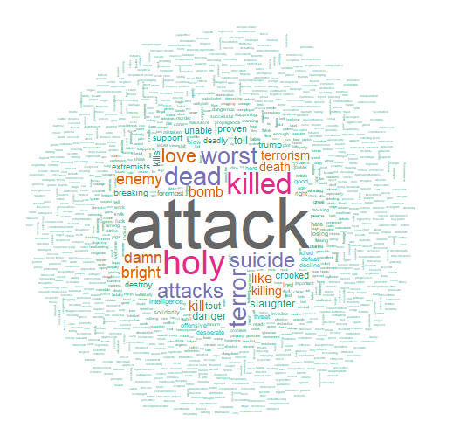
Sample Analysis
Word Plots
Bar Charts
Frequency tables
Model prototypes
Scatterplots
Boxplots

Slide 30
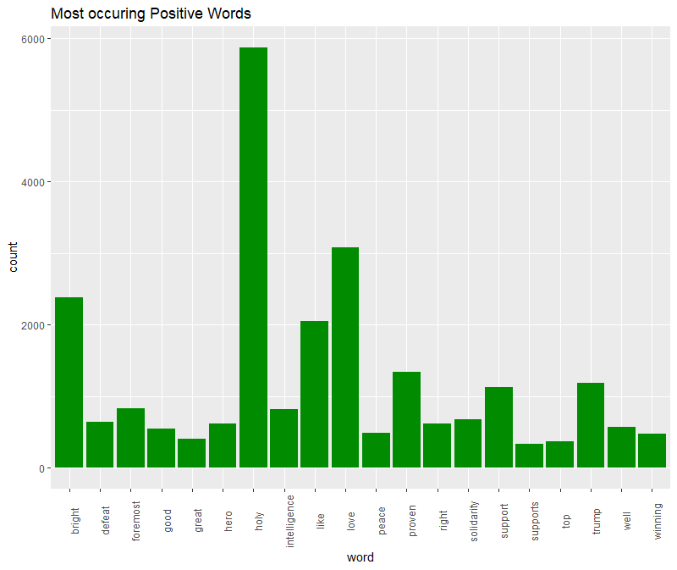
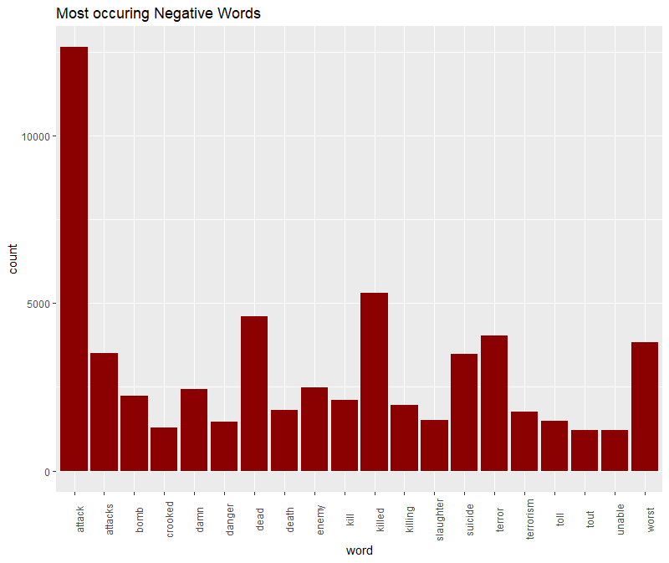
Sample Analysis

Slide 31


Sample Analysis
Actual proportions

Slide 32
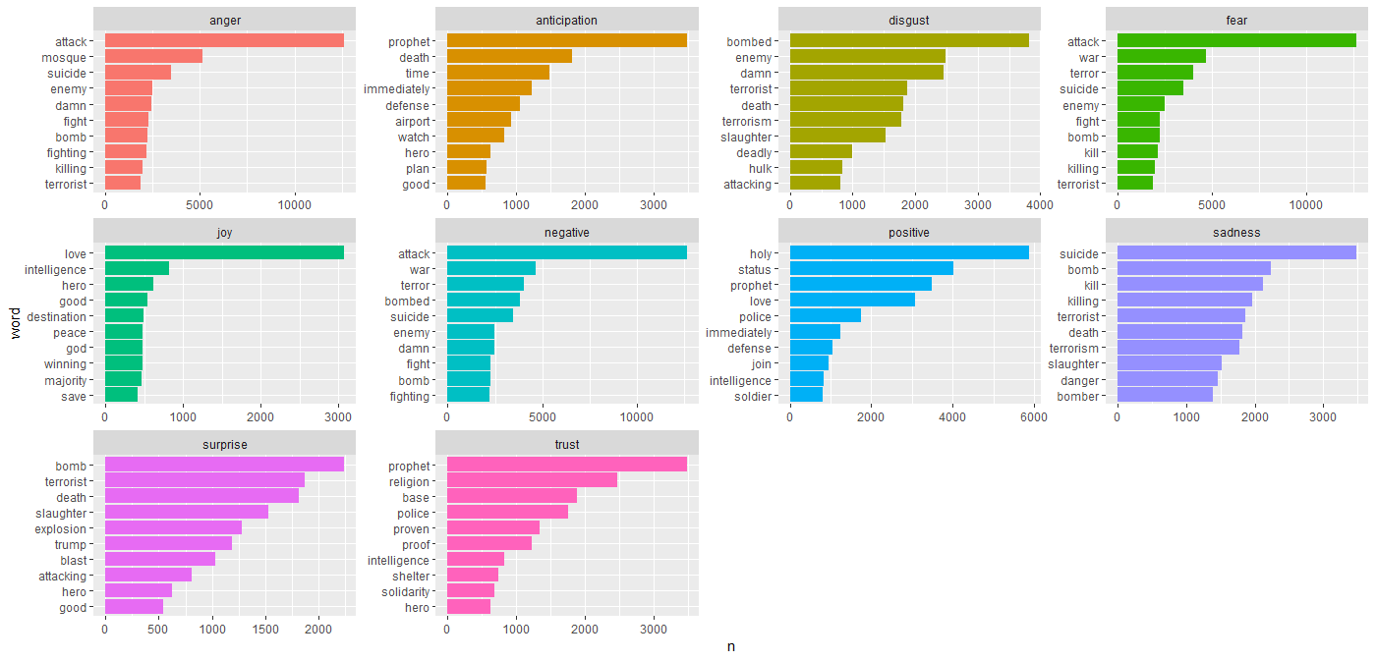
Sample Analysis

Slide 33
www.humalytica.com
http://www.amazon.com/Jeffrey-Strickland/e/B00IQ69QZK/
http://www.lulu.com/spotlight/strickland_jeffrey

